Slide 1

Chapter 15 –The Java Collections Framework

Slide 2

Chapter Goals
To learn how to use the collection classes supplied in the Java library
To use iterators to traverse collections
To choose appropriate collections for solving programming problems
To study applications of stacks and queues

Slide 3
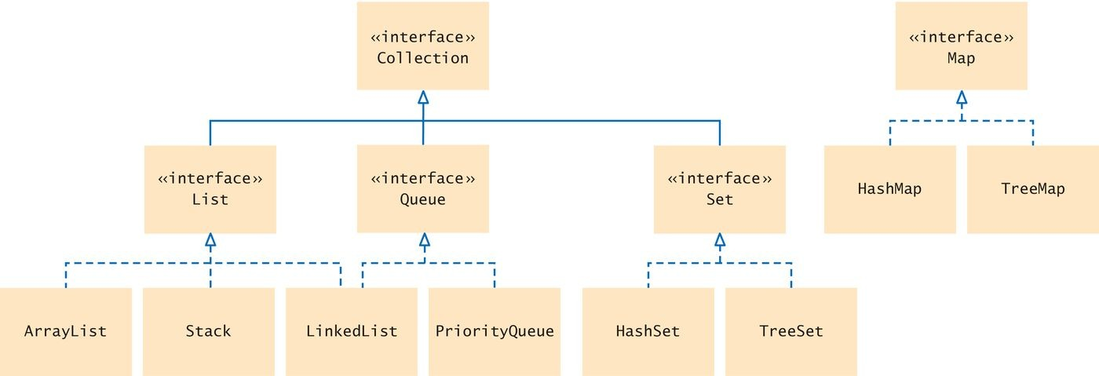
An Overview of the Collections Framework
A collection groups together elements and allows them to be retrieved later.
Java collections framework: a hierarchy of interface types and classes for collecting objects.
Each interface type is implemented by one or more classes
Figure 1 Interfaces and Classes in the Java Collections Framework
The Collection interface is at the root
All Collection class implement this interface
So all have a common set of methods

Slide 4

An Overview of the Collections Framework
List interface
A list is a collection that remembers the order of its elements. Two implementing classes
ArrayList LinkedList
Figure 2 A List of Books

Slide 5

An Overview of the Collections Framework
Set interface
A set is an unordered collection of unique elements.
Arranges its elements so that finding, adding, and removing elements is more efficient.
Two mechanisms to do this
hash tables
binary search trees
Figure 3 A Set of Books

Slide 6

An Overview of the Collections Framework
Stack
Remembers the order of elements
But you can only add and remove at the top
Figure 4 A Stack of Books

Slide 7

An Overview of the Collections Framework
Queue
Add items to one end (the tail) and remove them from the other end (the head)
A queue of people
A priority queue
an unordered collection
has an efficient operation for removing the element with the highest priority

Slide 8
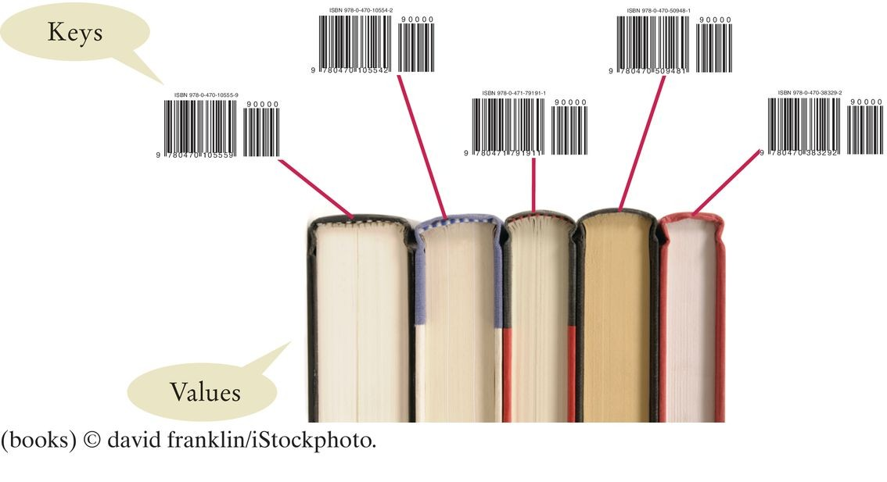
An Overview of the Collections Framework
Map
Keeps associations between key and value objects. Every key in the map has an associated value.
The map stores the keys, values, and the associations between them.
Figure 5 A Map from Bar Codes to Books

Slide 9
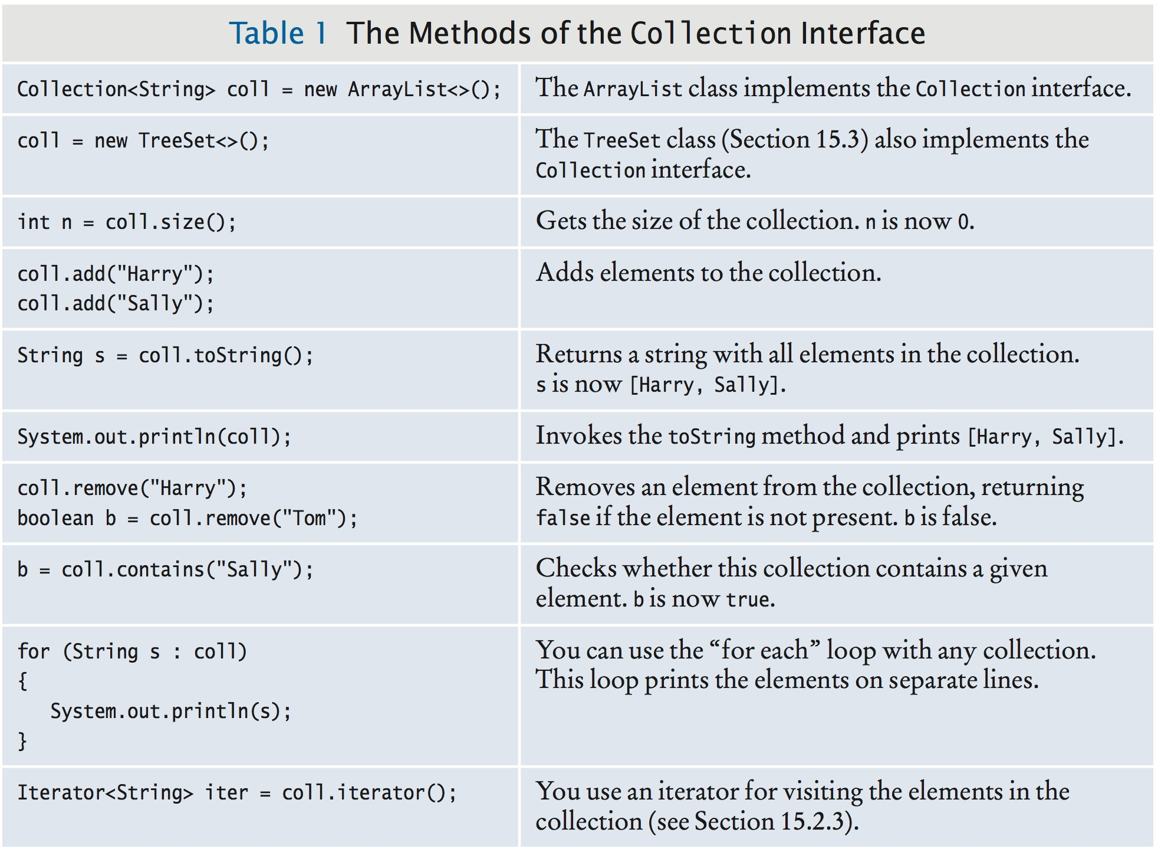
An Overview of the Collections Framework
Every class that implements the Collection interface has these methods.

Slide 10
Self Check 15.1
A gradebook application stores a collection of quizzes. Should it use a list or a set?
Answer: A list is a better choice because the application will want to retain the order in which the quizzes were given.

Slide 11
Self Check 15.2
A student information system stores a collection of student records for a university. Should it use a list or a set?
Answer: A set is a better choice. There is no intrinsically useful ordering for the students. For example, the registrar's office has little use for a list of all students by their GPA. By storing them in a set, adding, removing, and finding students can be efficient.

Slide 12
Self Check 15.3
Why is a queue of books a better choice than a stack for organizing your required reading?
Answer: With a stack, you would always read the latest required reading, and you might never get to the oldest readings.

Slide 13
Self Check 15.4
As you can see from Figure 1, the Java collections framework does not consider a map a collection. Give a reason for this decision.
Answer: A collection stores elements, but a map stores associations between elements.

Slide 14
The Diamond Syntax
Convenient syntax enhancement for array lists and other generic classes.
Mentioned in Chapter 7 Special Topic 7.5.
You can write:
ArrayList<String> names = new ArrayList<>();
instead of:
ArrayList<String> names = new ArrayList<String>();
This shortcut is called the "diamond syntax" because the empty brackets <> look like a diamond shape.
This chapter, and the following chapters, will use the diamond syntax for generic classes.

Slide 15

Linked Lists
A data structure used for collecting a sequence of objects:
Allows efficient addition and removal of elements in the middle of the sequence.
A linked list consists of a number of nodes;
Each node has a reference to the next node.
A node is an object that stores an element and references to the neighboring nodes.
Each node in a linked list is connected to the neighboring nodes.

Slide 16
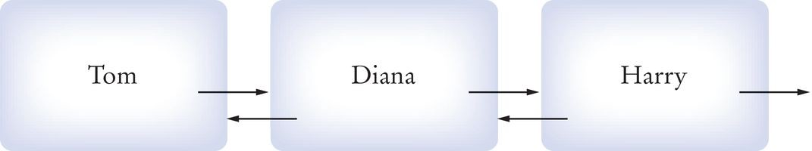
Linked Lists
Adding and removing elements in the middle of a linked list is efficient.
Visiting the elements of a linked list in sequential order is efficient. Random access is not efficient.
Figure 6 Example of a linked list

Slide 17
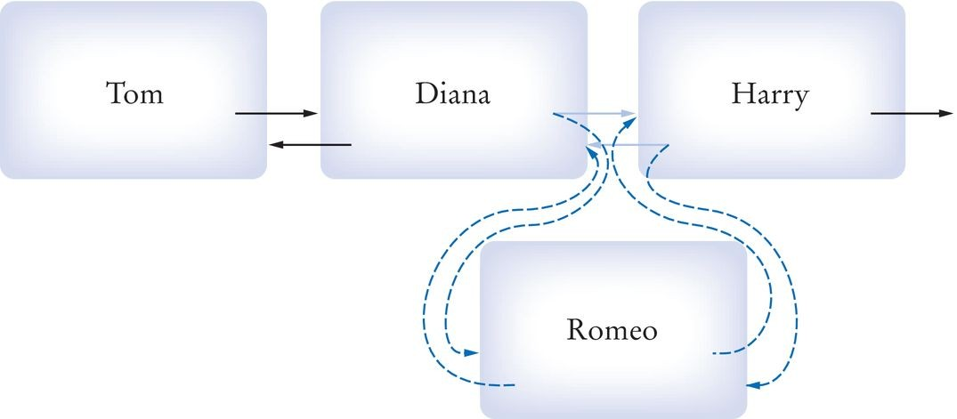
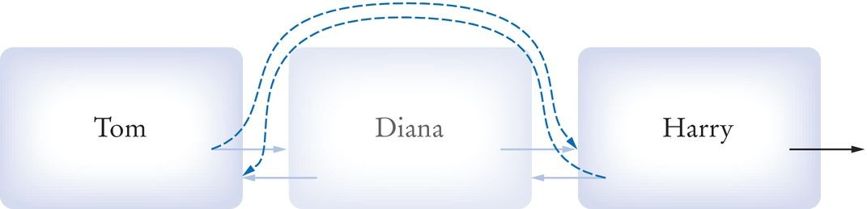
Linked Lists
When inserting or removing a node:
Only the neighboring node references need to be updated
Figure 7 Inserting a Node into a Linked List
Figure 8 Removing a Node From A Linked List
Visiting the elements of a linked list in sequential order is efficient. Random access is not efficient.

Slide 18
Linked Lists
When to use a linked list:
You are concerned about the efficiency of inserting or removing elements You rarely need element access in random order

Slide 19
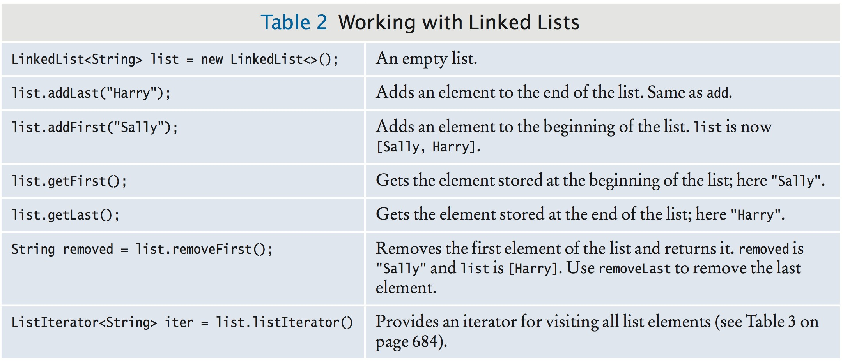
The LinkedList Class of the Java Collections Framework
Generic class
Specify type of elements in angle brackets: LinkedList<Product>
Package: java.util
LinkedList has the methods of the Collection interface. Some additional LinkedList methods:

Slide 20
List Iterator
Use a list iterator to access elements inside a linked list. Encapsulates a position anywhere inside the linked list. Think of an iterator as pointing between two elements:
Analogy: like the cursor in a word processor points between two characters
To get a list iterator, use the listIterator method of the
LinkedList class.
LinkedList<String> employeeNames = . . .; ListIterator<String> iterator = employeeNames.listIterator();
Also a generic type.

Slide 21
List Iterator
Initially points before the first element. Move the position with next method:
if (iterator.hasNext())
{
iterator.next();
}
The next method returns the element that the iterator is passing.
The return type of the next method matches the list iterator's type parameter.

Slide 22
List Iterator
To traverse all elements in a linked list of strings:
while (iterator.hasNext())
{
String name = iterator.next();
Do something with name
}
To use the “for each” loop:
for (String name : employeeNames)
{
Do something with name
}

Slide 23
List Iterator
The nodes of the LinkedList class store two links:
One to the next element One to the previous one Called a doubly-linked list
To move the list position backwards, use:
hasPrevious previous

Slide 24
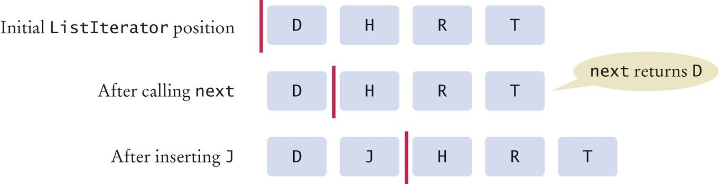
A List Iterator
The add method adds an object after the iterator.
Then moves the iterator position past the new element.
iterator.add("Juliet");
Figure 9 A Conceptual View of the List Iterator

Slide 25
List Iterator
The remove method:
Removes object that was returned by the last call to next or previous
To remove all names that fulfill a certain condition:
while (iterator.hasNext())
{
String name = iterator.next(); if (condition is fulfilled for name)
iterator.remove();
}
Be careful when calling remove:
It can be called only once after calling next or previous
You cannot call it immediately after a call to add
If you call it improperly, it throws an IllegalStateException

Slide 26
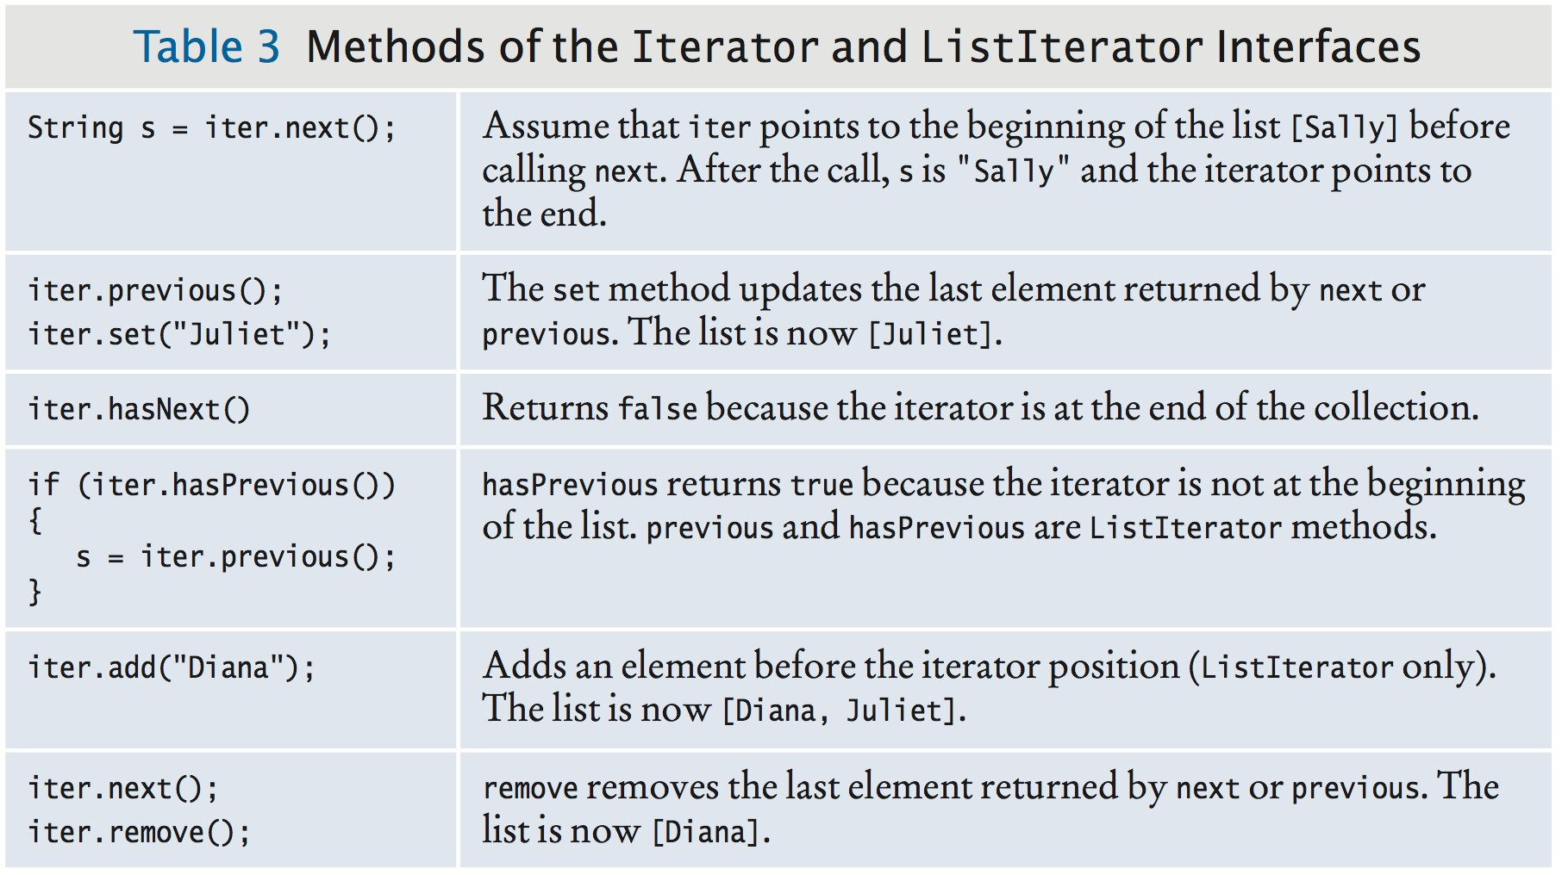
List Iterator
ListIterator interface extends Iterator interface. Methods of the Iterator and ListIterator Interfaces

Slide 27
Sample Program
ListDemo is a sample program that:
Inserts strings into a list
Iterates through the list, adding and removing elements Prints the list

Slide 28
section_2/ListDemo.java
import java.util.LinkedList;
import java.util.ListIterator;
3
4
5
6
7
8
9
/**
This program demonstrates the LinkedList class.
*/
public class ListDemo
{
public static void main(String[] args)
Program Run:
[Diana Harry Juliet Nina Tom]
Expected: [Diana Harry Juliet Nina Tom]

Slide 29
Self Check 15.5
Do linked lists take more storage space than arrays of the same size?
Answer: Yes, for two reasons. A linked list needs to store the neighboring node references, which are not needed in an arry. Moreover, there is some overhead for storing an object. In a linked list, each node is a separate object that incurs this overhead, whereas an array is a single object.

Slide 30
Self Check 15.6
Why don't we need iterators with arrays?
Answer: We can simply access each array element with an integer index.

Slide 31
Self Check 15.7
Suppose the list letters contains elements "A", "B", "C", and "D". Draw the contents of the list and the iterator position for the following operations:
ListIterator<String> iter = letters.iterator(); iter.next();
iter.next(); iter.remove(); iter.next(); iter.add("E"); iter.next(); iter.add("F");
Answer:
|ABCD A|BCD AB|CD A|CD AC|D ACE|D ACED| ACEDF|

Slide 32
Self Check 15.8
Write a loop that removes all strings with length less than four from a linked list of strings called words.
Answer:
ListIterator<String> iter = words.iterator(); while (iter.hasNext())
{
String str = iter.next();
if (str.length() < 4) { iter.remove(); }
}

Slide 33
Self Check 15.9
Write a loop that prints every second element of a linked list of strings called words.
Answer:
ListIterator<String> iter = words.iterator(); while (iter.hasNext())
{
System.out.println(iter.next()); if (iter.hasNext())
{
iter.next(); // Skip the next element
}
}

Slide 34
Sets
A set organizes its values in an order that is optimized for efficiency.
May not be the order in which you add elements.
Inserting and removing elements is more efficient with a set than with a list.

Slide 35
Sets
The Set interface has the same methods as the Collection
interface.
A set does not admit duplicates. Two implementing classes
HashSet based on hash table
TreeSet based on binary search tree
A Set implementation arranges the elements so that it can locate them quickly.

Slide 36

Sets
In a hash table
Set elements are grouped into smaller collections of elements that share the same characteristic.
Grouped by an integer hash code that is computed from the element.
Elements in a hash table must implement the method hashCode. Must have a properly defined equals method.
You can form hash sets holding objects of type String, Integer, Double, Point, Rectangle, or Color.
HashSet<String>, HashSet<Rectangle>, or a
HashSet<HashSet<Integer>>
On this shelf, books of the same color are grouped together. Similarly, in a hash table, objects with the same hash code are placed in the same group.

Slide 37

Sets
In a TreeSet
Elements are kept in sorted order
Elements are stored in nodes.
The nodes are arranged in a tree shape,
Not in a linear sequence
You can form tree sets for any class that implements the
Comparable interface:
Example: String or Integer.

Slide 38
Sets
Use a TreeSet if you want to visit the set's elements in sorted order.
Otherwise choose a HashSet.
It is a bit more efficient — if the hash function is well chosen.

Slide 39
Sets
Store the reference to a TreeSet or HashSet in a
Set<String> variable:
Set<String> names = new HashSet<>();
or
Set<String> names = new TreeSet<>();
After constructing the collection object:
The implementation no longer matters Only the interface is important

Slide 40
Working with Sets
Adding and removing elements:
names.add("Romeo"); names.remove("Juliet");
Sets don't have duplicates.
Adding a duplicate is ignored.
Attempting to remove an element that isn't in the set is ignored.
The contains method tests whether an element is contained in the set:
if (names.contains("Juliet")) . . .
The contains method uses the equals method of the element type

Slide 41
Working with Sets
To process all elements in the set, get an iterator.
A set iterator visits the elements in the order in which the set implementation keeps them.
Iterator<String> iter = names.iterator(); while (iter.hasNext())
{
String name = iter.next();
Do something with name
}
You can also use the “for each” loop
for (String name : names)
{
Do something with name
}
You cannot add an element to a set at an iterator position - A set is unordered.
You can remove an element at an iterator position. The iterator interface as no previous method.

Slide 42
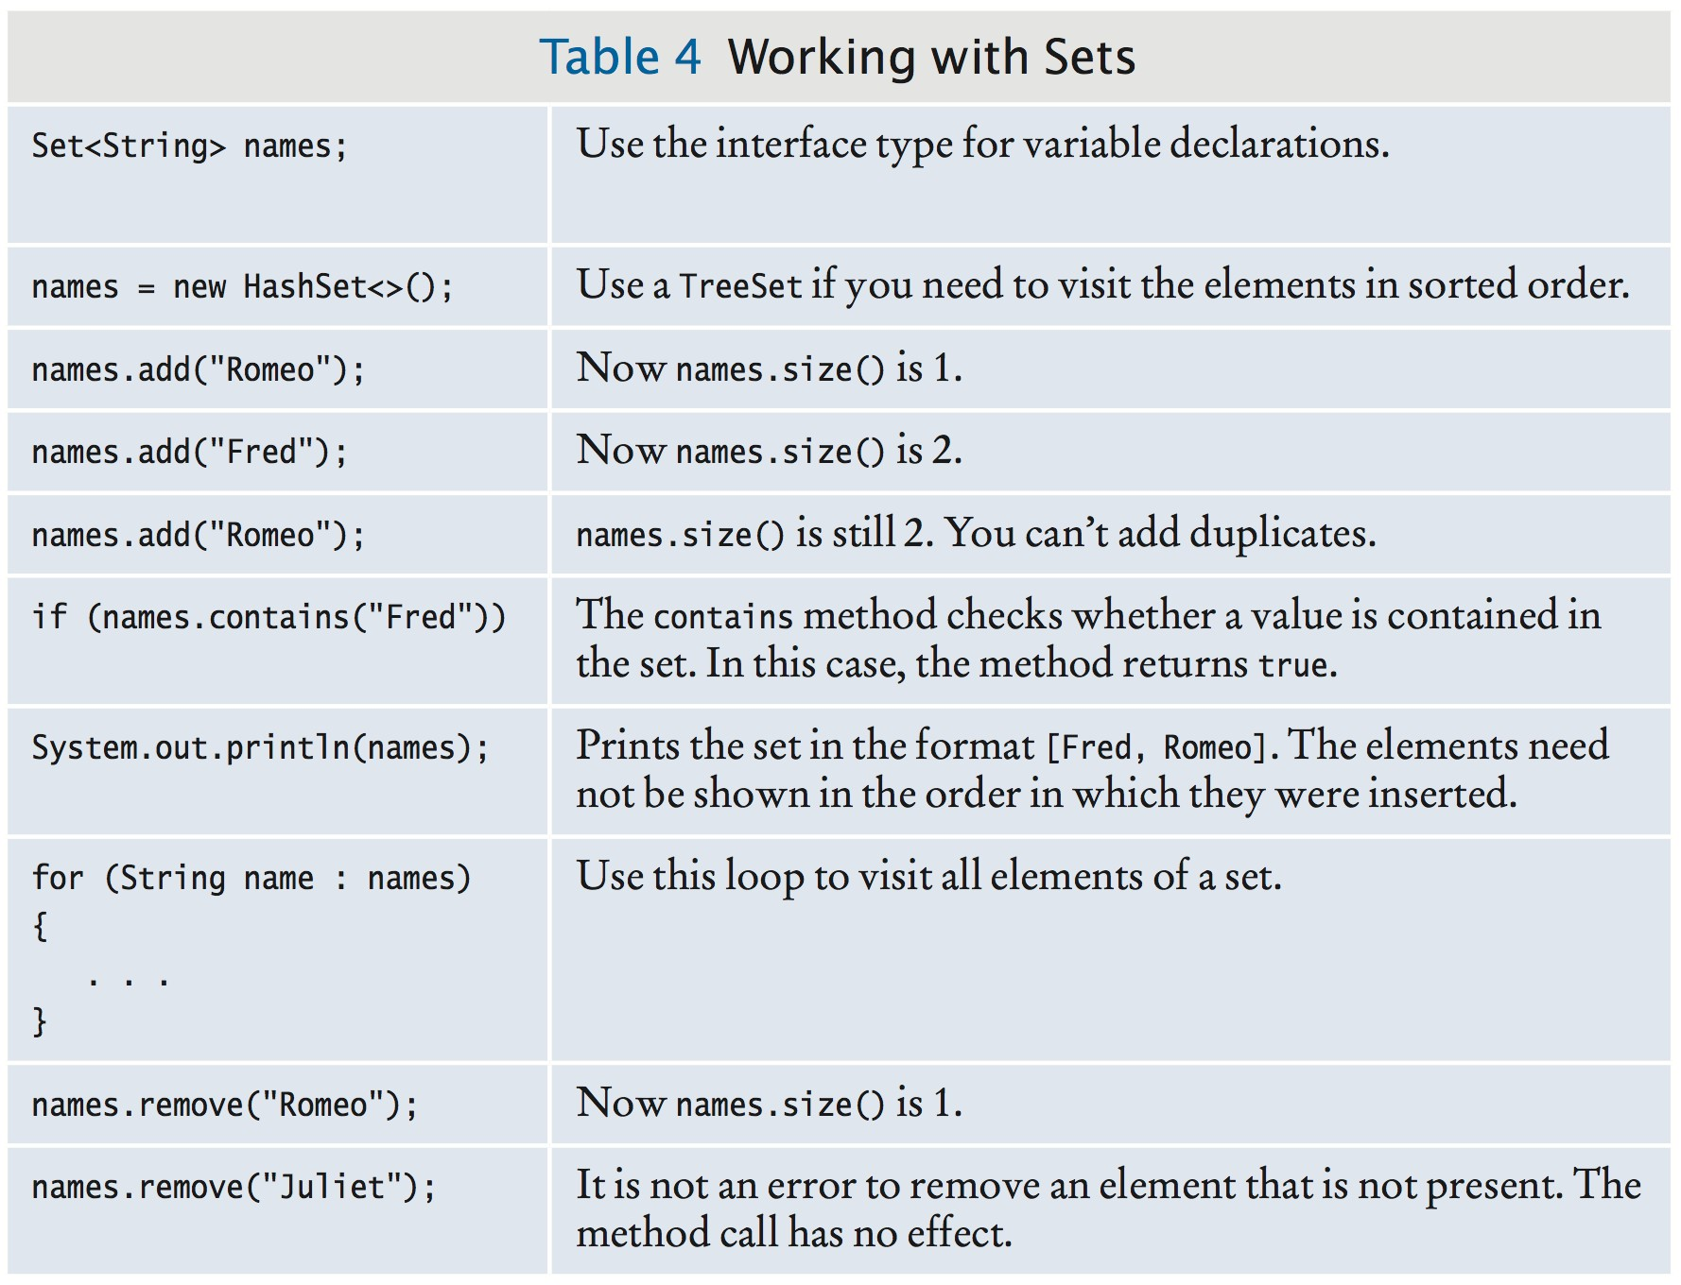
Working with Sets

Slide 43
SpellCheck Example Program
Read all the correctly spelled words from a dictionary file
Put them in a set
Reads all words from a document
Put them in a second set
Print all the words in the second set that are not in the dictionary set.
Potential misspellings

Slide 44
section_3/SpellCheck.java
import java.util.HashSet;
import java.util.Scanner;
import java.util.Set;
import java.io.File;
import java.io.FileNotFoundException;
6
7
8
9
10
11
12
13
14
15
16
17
18
19
20
21
22
23
24
25
26
27
28
29
30
31
32
33
34
/**
This program checks which words in a file are not present in a dictionary.
*/
public class SpellCheck
{
public static void main(String[] args) throws FileNotFoundException
{
// Read the dictionary and the document
Set<String> dictionaryWords = readWords("words"); Set<String> documentWords = readWords("alice30.txt");
// Print all words that are in the document but not the dictionary
for (String word : documentWords)
{
if (!dictionaryWords.contains(word))
{
System.out.println(word);
}
}
}
/**
Reads all words from a file.
@param filename the name of the file
@return a set with all lowercased words in the file. Here, a
35
word is a sequence of upper- and lowercase letters.

Slide 45
Program Run:
neighbouring croqueted pennyworth dutchess comfits
xii dinn clamour

Slide 46
Self Check 15.10
Arrays and lists remember the order in which you added elements; sets do not. Why would you want to use a set instead of an array or list?
Answer: Adding and removing elements as well as testing for membership is more efficient with sets.

Slide 47
Self Check 15.11
Why are set iterators different from list iterators?
Answer: Sets do not have an ordering, so it doesn't make sense to add an element at a particular iterator position, or to traverse a set backward.

Slide 48
Self Check 15.12
What is wrong with the following test to check whether the Set<String>s contains the elements "Tom", "Diana", and "Harry"?
if (s.toString().equals("[Tom, Diana, Harry]")) . . .
Answer: You do not know in which order the set keeps the elements.

Slide 49
Self Check 15.13
How can you correctly implement the test of Self Check 12?
Answer: Here is one possibility:
if (s.size() == 3 && s.contains("Tom") && s.contains("Diana")
&& s.contains("Harry"))
. . .

Slide 50
Self Check 15.14
Write a loop that prints all elements that are in both Set<String>s and
Set<String>t.
Answer:
for (String str : s)
{
if (t.contains(str))
{
System.out.println(str);
}
}

Slide 51
Self Check 15.15
Suppose you changed line 40 of the SpellCheck program to use a TreeSet instead of a HashSet. How would the output change?
Answer: The words would be listed in sorted order.

Slide 52
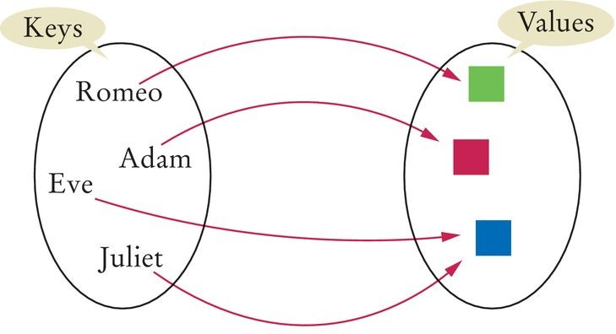
Maps
A map allows you to associate elements from a key set with elements from a value collection.
Use a map when you want to look up objects by using a key.
Figure 10 A Map
Two implementations of the Map interface:
HashMap TreeMap
Store the reference to the map object in a Map reference:
Map<String, Color> favoriteColors = new HashMap<>();

Slide 53
Maps
Use the put method to add an association:
favoriteColors.put("Juliet", Color.RED);
You can change the value of an existing association by calling
put again:
favoriteColors.put("Juliet", Color.BLUE);
The get method returns the value associated with a key:
Color julietsFavoriteColor = favoriteColors.get("Juliet");
If you ask for a key that isn't associated with any values, the get
method returns null.
To remove an association, call the remove method with the key:
favoriteColors.remove("Juliet");

Slide 54
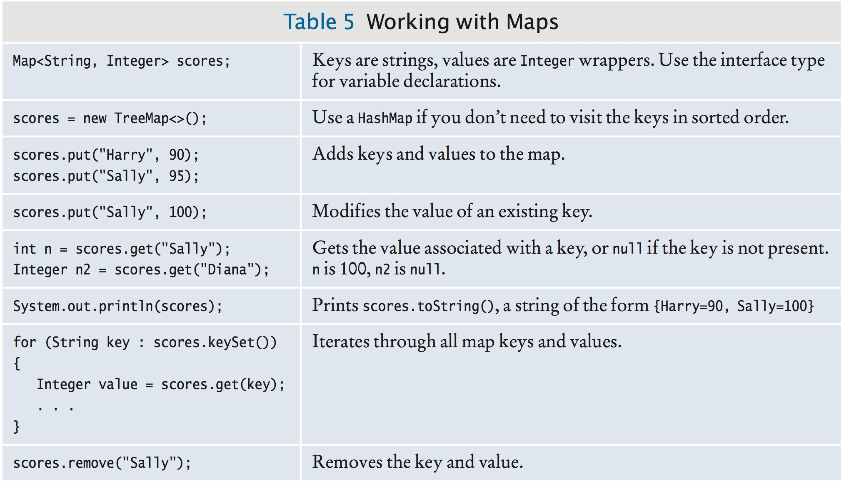
Working with Maps

Slide 55
Map
Sometimes you want to enumerate all keys in a map. The keySet method yields the set of keys.
Ask the key set for an iterator and get all keys.
For each key, you can find the associated value with the get
method.
To print all key/value pairs in a map m:
Set<String> keySet = m.keySet(); for (String key : keySet)
{
Color value = m.get(key); System.out.println(key + "->" + value);
}

Slide 56
section_4/MapDemo.java
import java.awt.Color;
import java.util.HashMap;
import java.util.Map;
import java.util.Set;
5
6
7
8
9
10
11
12
13
14
15
16
17
18
19
20
21
22
23
24
25
26
27
28 }
/**
This program demonstrates a map that maps names to colors.
*/
public class MapDemo
{
public static void main(String[] args)
{
Map<String, Color> favoriteColors = new HashMap<>(); favoriteColors.put("Juliet", Color.BLUE); favoriteColors.put("Romeo", Color.GREEN); favoriteColors.put("Adam", Color.RED); favoriteColors.put("Eve", Color.BLUE);
// Print all keys and values in the map
Set<String> keySet = favoriteColors.keySet(); for (String key : keySet)
{
Color value = favoriteColors.get(key); System.out.println(key + " : " + value);
}
}
Program Run:
Juliet : java.awt.Color[r=0,g=0,b=255] Adam : java.awt.Color[r=255,g=0,b=0] Eve : java.awt.Color[r=0,g=0,b=255] Romeo : java.awt.Color[r=0,g=255,b=0]

Slide 57
Self Check 15.16
What is the difference between a set and a map?
Answer: A set stores elements. A map stores associations between keys and values.

Slide 58
Self Check 15.17
Why is the collection of the keys of a map a set and not a list?
Answer: The ordering does not matter, and you cannot have duplicates

Slide 59
Self Check 15.18
Why is the collection of the values of a map not a set?
Answer: Because it might have duplicates.

Slide 60
Self Check 15.19
Suppose you want to track how many times each word occurs in a document. Declare a suitable map variable.
Answer: Map<String, Integer> wordFrequency;

Slide 61
Self Check 15.20
What is a Map<String, HashSet<String>>? Give a possible use for such a structure.
Answer: It associates strings with sets of strings. One application would be a thesaurus that lists synonyms for a given word. For example, the key "improve" might have as its value the set ["ameliorate", "better", "enhance", "enrich", "perfect", "refine"].

Slide 62
Java 8 Note 15.1
Updating Map Entries used to be tedious
Integer count = frequencies.get(word); // Get the old frequency count
// If there was none, put 1; otherwise, increment the count if (count == null) { count = 1; }
else { count = count + 1; } frequencies.put(word, count);
New merge method in Map interface Specify:
Key
Value to be used if key not yet present
Function to compute the updated value if key is present
Replace code above with single line using lambda expression:
frequencies.merge(word, 1, (oldValue, value) -> oldValue + value);

Slide 63
Choosing a Collection
Determine how you access the values.
Determine the element types or key/value types.
Determine whether element or key order matters.
For a collection, determine which operations must be efficient.
For hash sets and maps, decide whether you need to implement the hashCode and equals methods.
If you use a tree, decide whether to supply a comparator.

Slide 64
Hash Functions
You may need to implement a hash function for your own classes.
A hash function: a function that computes an integer value, the hash code, from an object in such a way that different objects are likely to yield different hash codes.
Object class has a hashCode method
you need to override it to use your class in a hash table
A collision: two or more objects have the same hash code.
The method used by the String class to compute the hash code.
final int HASH_MULTIPLIER = 31; int h = 0;
for (int i = 0; i < s.length(); i++)
{
h = HASH_MULTIPLIER * h + s.charAt(i);
}
This produces different hash codes for "tea" and "eat".

Slide 65

Hash Functions
A good hash function produces different hash values for each object so that they are scattered about in a hash table.

Slide 66
Hash Functions
Override hashCode methods in your own classes by combining the hash codes for the instance variables.
A hash function for our Country class:
public class Country
{
public int hashCode()
{
int h1 = name.hashCode();
int h2 = new Double(area).hashCode(); final int HASH_MULTIPLIER = 29;
int h = HASH_MULTIPLIER * h1 + h2;
return h;
}
}
Easier to use Objects.hash() method
Takes hashcode of all arguments and multiplies them:
public int hashCode()
{
return Objects.hash(name, area);
}
A class's hashCode method must be compatible with its equals
method.

Slide 67

Stacks
A stack lets you insert and remove elements only at one end:
Called the top of the stack.
Removes items in the opposite order than they were added Last-in, first-out or LIFO order
Add and remove methods are called push and pop. Example
Stack<String> s = new Stack<>(); s.push("A"); s.push("B"); s.push("C"); while (s.size() > 0)
{
System.out.print(s.pop() + " "); // Prints C B A
}
The last pancake that has been added to this stack will be the first one that is consumed.

Slide 68

Stacks
Many applications for stacks in computer science. Consider: Undo function of a word processor
The issued commands are kept in a stack.
When you select “Undo”, the last command is popped off the stack and undone.
Run-time stack that a processor or virtual machine:
Stores the values of variables in nested methods.
When a new method is called, its parameter variables and local variables are pushed onto a stack.
When the method exits, they are popped off again.

Slide 69
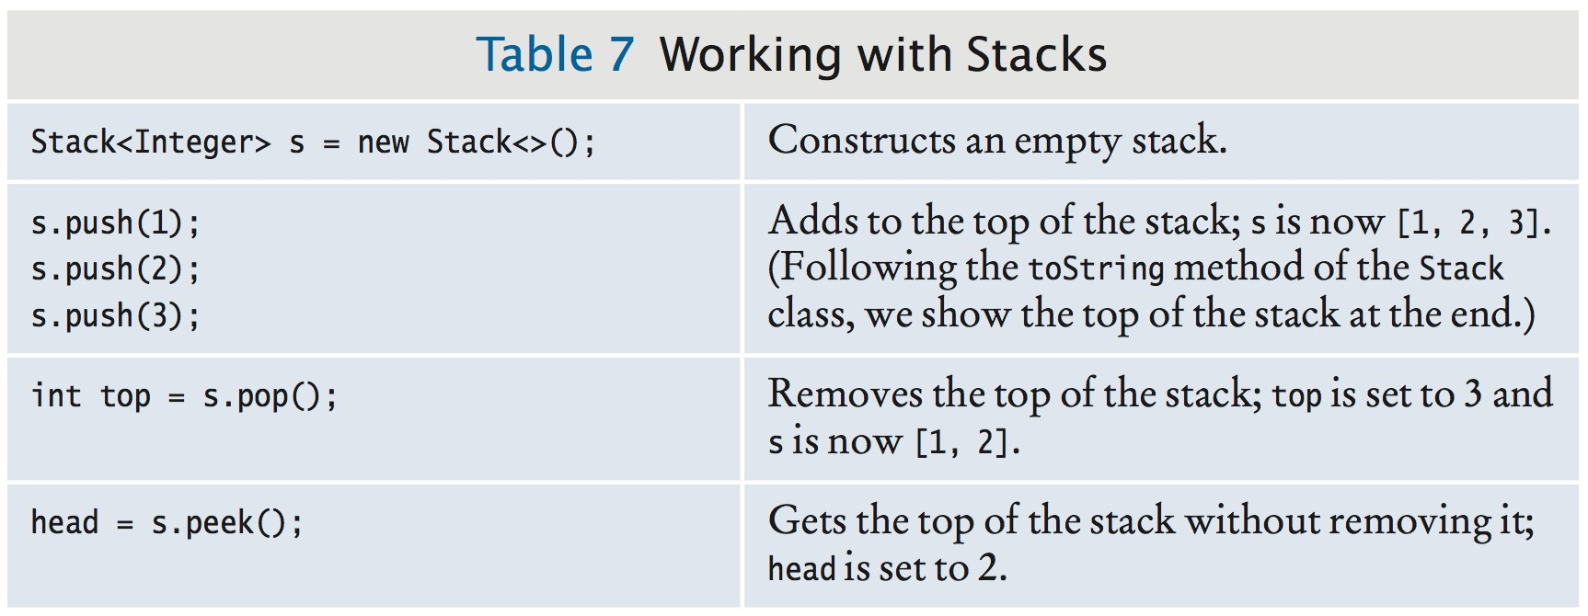
Stack in the Java Library
Stack class provides push, pop and peek methods.

Slide 70
Queue
A queue
Lets you add items to one end of the queue (the tail) Remove items from the other end of the queue (the head)
Items are removed in the same order in which they were added First-in, first-out or FIFO order
To visualize a queue, think of people lining up.
Typical application: a print queue.

Slide 71
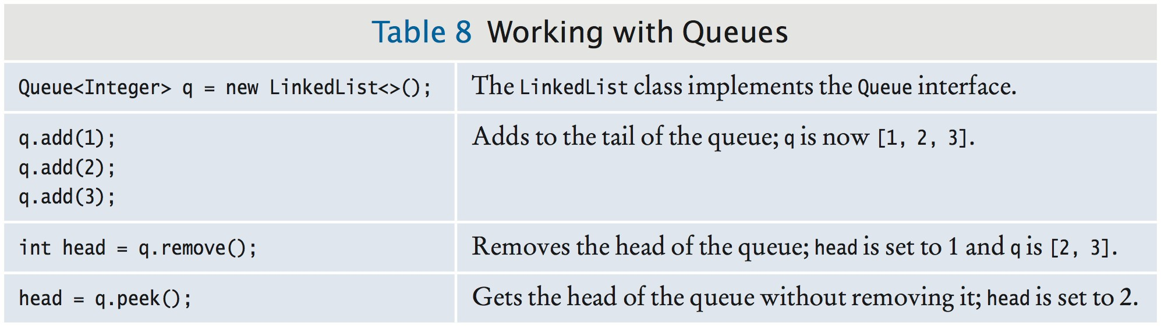
Queue
The Queue interface in the standard Java library has:
an add method to add an element to the tail of the queue, a remove method to remove the head of the queue, and
a peek method to get the head element of the queue without removing it.
The LinkedList class implements the Queue interface. When you need a queue, initialize a Queue variable with a
LinkedList object:
Queue<String> q = new LinkedList<>(); q.add("A"); q.add("B"); q.add("C");
while (q.size() > 0) { System.out.print(q.remove() + " "); } // Prints A B C

Slide 72

Priority Queues
A priority queue collects elements, each of which has a priority. Example: a collection of work requests, some of which may be more urgent than others.
Does not maintain a first-in, first-out discipline. Elements are retrieved according to their priority. Priority 1 denotes the most urgent priority.
Each removal extracts the minimum element.
When you retrieve an item from a priority queue, you always get the most urgent one.

Slide 73
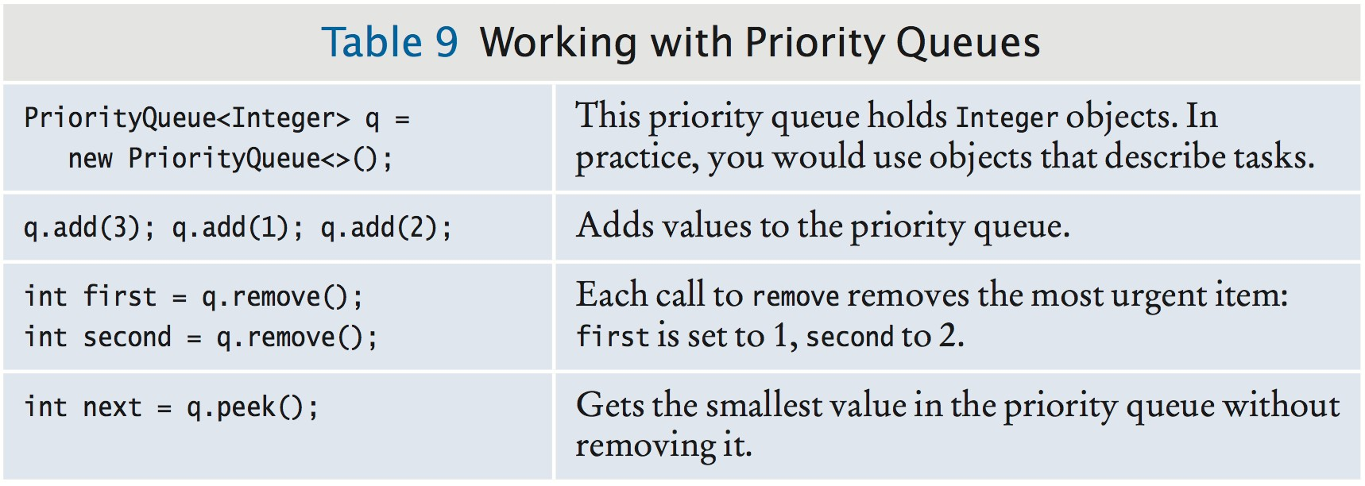
Priority Queues
Example: objects of a class WorkOrder into a priority queue.
PriorityQueue<WorkOrder> q = new PriorityQueue<>(); q.add(new WorkOrder(3, "Shampoo carpets")); q.add(new WorkOrder(1, "Fix broken sink")); q.add(new WorkOrder(2, "Order cleaning supplies"));
When calling q.remove() for the first time, the work order with priority 1 is removed.
Elements should belong to a class that implements the
Comparable interface.

Slide 74
Self Check 15.21
Why would you want to declare a variable as
Queue<String> q = new LinkedList<>();
instead of simply declaring it as a linked list?
Answer: This way, we can ensure that only queue operations can be invoked on the q object.

Slide 75
Self Check 15.22
Why wouldn't you want to use an array list for implementing a queue?
Answer: Depending on whether you consider the 0 position the head or the tail of the queue, you would either add or remove elements at that position. Both are inefficient operations because all other elements need to be moved.

Slide 76
Self Check 15.23
What does this code print?
Queue<String> q = new LinkedList<>(); q.add("A");
q.add("B");
q.add("C");
while (q.size() > 0) { System.out.print(q.remove() + " "); }
Answer: A B C

Slide 77
Self Check 15.24
Why wouldn't you want to use a stack to manage print jobs?
Answer: Stacks use a “last-in, first-out” discipline. If you are the first one to submit a print job and lots of people add print jobs before the printer has a chance to deal with your job, they get their printouts first, and you have to wait until all other jobs are completed.

Slide 78
Self Check 15.25
In the sample code for a priority queue, we used a WorkOrder class. Could we have used strings instead?
PriorityQueue<String> q = new PriorityQueue<>(); q.add("3 - Shampoo carpets");
q.add("1 - Fix broken sink"); q.add("2 - Order cleaning supplies");
Answer: Yes––the smallest string (in lexicographic ordering) is removed first. In the example, that is the string starting with 1, then the string starting with 2, and so on. However, the scheme breaks down if a priority value exceeds 9. For example, a string "10 - Line up braces" comes before "2 - Order cleaning supplies" in lexicographic order.

Slide 79
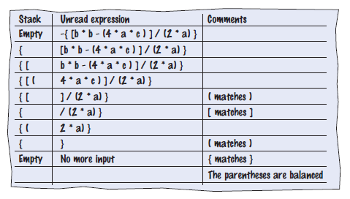
Stack and Queue Applications
A stack can be used to check whether parentheses in an expression are balanced.
When you see an opening parenthesis, push it on the stack. When you see a closing parenthesis, pop the stack.
If the opening and closing parentheses don't match The parentheses are unbalanced. Exit.
If at the end the stack is empty The parentheses are balanced.
Else
The parentheses are not balanced.
Walkthrough of the sample expression:

Slide 80
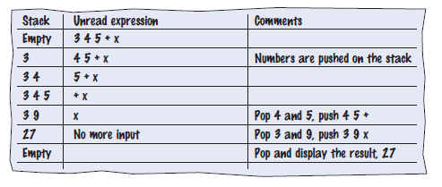
Stack and Queue Applications
Use a stack to evaluate expressions in reverse Polish notation.
If you read a number Push it on the stack.
Else if you read an operand Pop two values off the stack.
Combine the values with the operand. Push the result back onto the stack.
Else if there is no more input Pop and display the result.
Walkthrough of evaluating the expression 3 4 5 + ×:

Slide 81
section_6_2/Calculator.java
import java.util.Scanner;
import java.util.Stack;
3
4 /**
5 This calculator uses the reverse Polish notation.
6 */
7 public class Calculator
8 {
9 public static void main(String[] args)
10 {
Scanner in = new Scanner(System.in);
Stack<Integer> results = new Stack<>();
System.out.println("Enter one number or operator per line, Q to quit. ");
boolean done = false;
while (!done)
16 {
17 String input = in.nextLine();
18
19
20
21
22
23
24
25
26
27
28
29
30
31
32
33
34
35
36
// If the command is an operator, pop the arguments and push the result
if (input.equals("+"))
{
results.push(results.pop() + results.pop());
}
else if (input.equals("-"))
{
Integer arg2 = results.pop(); results.push(results.pop() - arg2);
}
else if (input.equals("*") || input.equals("x"))
{
results.push(results.pop() * results.pop());
}
else if (input.equals("/"))
{
Integer arg2 = results.pop();

Slide 82

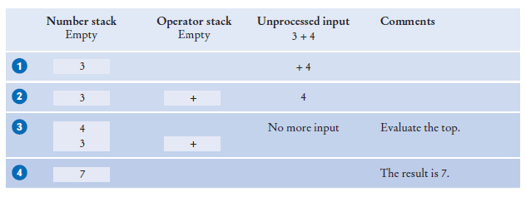
Evaluating Algebraic Expressions with Two Stacks
Using two stacks, you can evaluate expressions in standard algebraic notation.
One stack for numbers, one for operators
Evaluating the top: 3 + 4

Slide 83
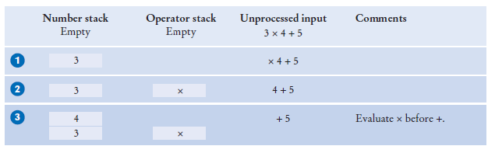
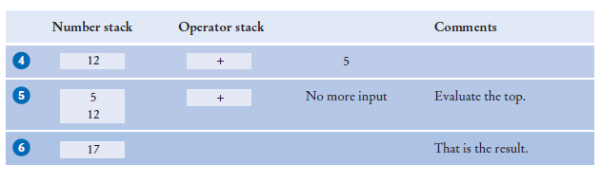
Evaluating Algebraic Expressions with Two Stacks
Evaluate 3 x 4 + 5
Push until you get to the +
x (top of operator stack) has higher precedence than + , so evaluate the top

Slide 84
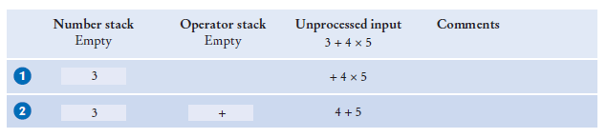
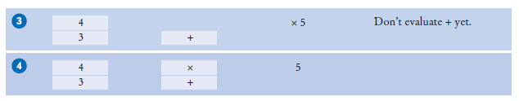
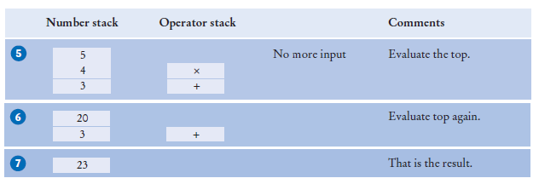
Evaluating Algebraic Expressions with Two Stacks
Evaluate 3 + 4 × 5
Add x to the operator stack so we can get the next number
Keep operators on the stack until they are ready to be evaluated

Slide 85
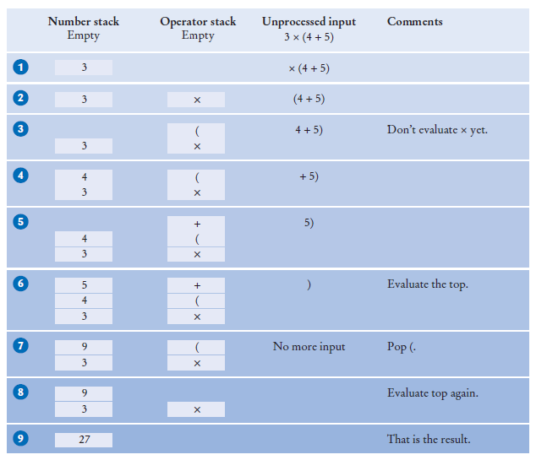
Evaluating Algebraic Expressions with Two Stacks
Evaluating parentheses: 3 × (4 + 5)
Push ( on the stack
Keep pushing until we reach the )
Evaluate until we find the matching (

Slide 86
Evaluating Algebraic Expressions with Two Stacks
The algorithm
If you read a number
Push it on the number stack. Else if you read a (
Push it on the operator stack. Else if you read an operator op
While the top of the stack has a higher precedence than op Evaluate the top.
Push op on the operator stack. Else if you read a )
While the top of the stack is not a ( Evaluate the top.
Pop the (.
Else if there is no more input
While the operator stack is not empty Evaluate the top.
At the end, the value on the number stack is the value of the expression.

Slide 87
Evaluating Algebraic Expressions with Two Stacks
Helper method to evaluate the top:
Pop two numbers off the number stack. Pop an operator off the operator stack. Combine the numbers with that operator. Push the result on the number stack.

Slide 88

Backtracking
Use a stack to remember choices you haven't yet made so that you can backtrack to them.
Escaping a maze
You want to escape from a maze.
You come to an intersection. What should you do? Explore one of the paths.
But remember the other paths.
If your chosen path doesn't work, you can
go back and try one of the other choices.
Use a stack to remember the paths that still need to be tried.
The process of returning to a choice point and trying another choice is called backtracking.

Slide 89
Backtracking - Maze Example
Start, at position (3, 4).
There are four possible paths. We push them all on a stack . We pop off the topmost one, traveling north from (3, 4).
Following this path leads to position (1, 4).
We now push two choices on the stack, going west or east . Both of them lead to dead ends .
Now we pop off the path from (3,4) going east.
That too is a dead end .
Next is the path from (3, 4) going south. Comes to an intersection at (5, 4).
Both choices are pushed on the stack . They both lead to dead ends .
Finally, the path from (3, 4) going west leads to an exit .

Slide 90
Backtracking
Figure 11 Backtracking Through a Maze

Slide 91
Backtracking
Algorithm:
Push all paths from the point on which you are standing on a stack. While the stack is not empty
Pop a path from the stack.
Follow the path until you reach an exit, intersection, or dead end. If you found an exit
Congratulations!
Else if you found an intersection
Push all paths meeting at the intersection, except the current one, onto the stack.
This works if there are no cycles in the maze.
You never circle back to a previously visited intersection
You could use a queue instead of a stack.

Slide 92
Self Check 15.26
What is the value of the reverse Polish notation expression 2 3 4 + 5 × ×?
Answer: 70

Slide 93
Self Check 15.27
Why does the branch for the subtraction operator in the Calculator program not simply execute?
results.push(results.pop() - results.pop());
Answer: It would then subtract the first argument from the second. Consider the input 5 3 –. The stack contains 5 and 3, with the 3 on the top. Then results.pop() - results.pop() computes 3 – 5.

Slide 94
Self Check 15.28
In the evaluation of the expression 3 – 4 + 5 with the algorithm of Section 15.6.3, which operator gets evaluated first?
Answer: The – gets executed first because + doesn't have a higher precedence.

Slide 95
Self Check 15.29
In the algorithm of Section 15.6.3, are the operators on the operator stack always in increasing precedence?
Answer: No, because there may be parentheses on the stack. The parentheses separate groups of operators, each of which is in increasing precedence.

Slide 96
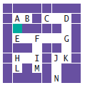
Self Check 15.30
Consider the following simple maze. Assuming that we start at the marked point and push paths in the order West, South, East, North, in which order are the lettered points visited, using the algorithm of Section 15.6.4?
Answer: A B E F G D C K J N

